Slide 1
Macro Announcement Days Pitch
Quant Team
Ellie Evans, Brandon Ly, Mark Rose
3/4/2021

Slide 2
Why macro announcement days matter
CAPM says market beta should be sole determinant of excess returns
Historically, low beta stocks outperform high beta stocks
Frazzini & Pedersen (2014); Bates & Boyer (2020)
Does a high beta ever correspond with high excess returns?
If we can predict when this relationship will hold, we can time our BAB (betting against beta) strategy
Notes:
Stock market average returns and Sharpe ratios are signiÖcantly higher on days when important macroeconomic news about ináation, unemployment, or interest rates is scheduled for announcement.

Slide 3
Replicating beta-stock return relationships
Savor & Mungo (2013) split trading days into:
announcement days (a-days)
non-announcement days (n-days)
A-days: scheduled FOMC interest rate meetings, CPI/PPI announcements, and unemployment announcements
We use time series Fama-MacBeth regressions on stock portfolios & individual stocks

Slide 4
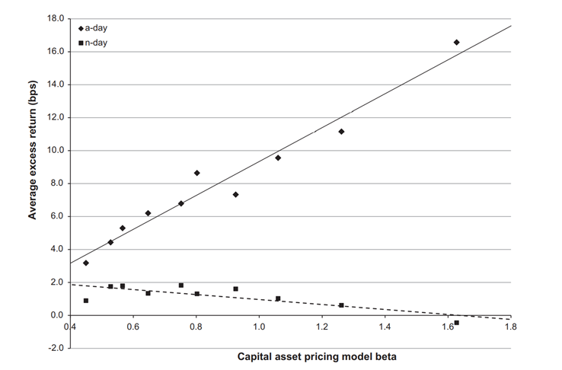

Slide 5
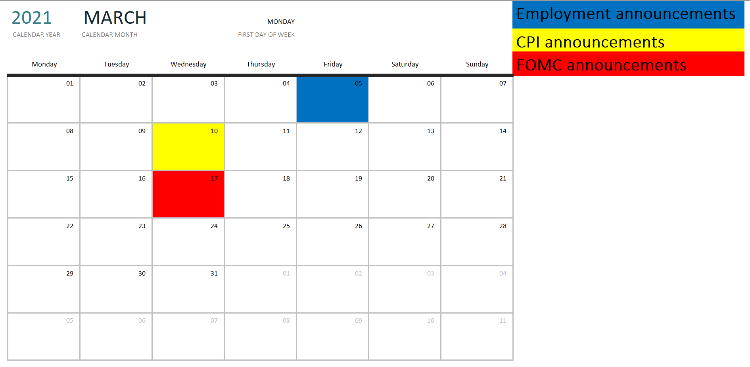

Slide 6
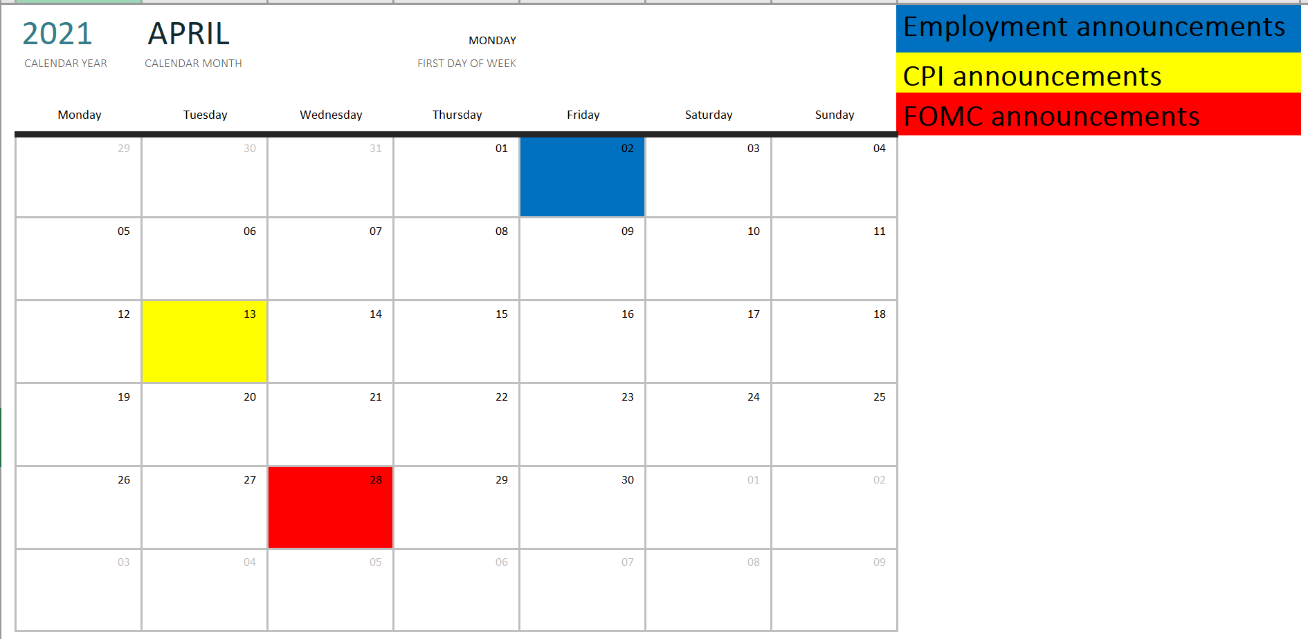

Slide 7
Upcoming a-days
Date | Type
1/8/2021 | Emp
1/13/2021 | CPI
1/27/2021 | FOMC
2/5/2021 | Emp
2/10/2021 | CPI
3/5/2021 | Emp
3/10/2021 | CPI
3/17/2021 | FOMC
4/2/2021 | Emp
4/13/2021 | CPI
Date | Type
4/28/2021 | FOMC
5/7/2021 | Emp
5/12/2021 | CPI
6/4/2021 | Emp
6/10/2021 | CPI
6/16/2021 | FOMC
7/2/2021 | Emp
7/13/2021 | CPI
7/28/2021 | FOMC
8/6/2021 | Emp
Notes:
32 total a-days for 2021

Slide 8
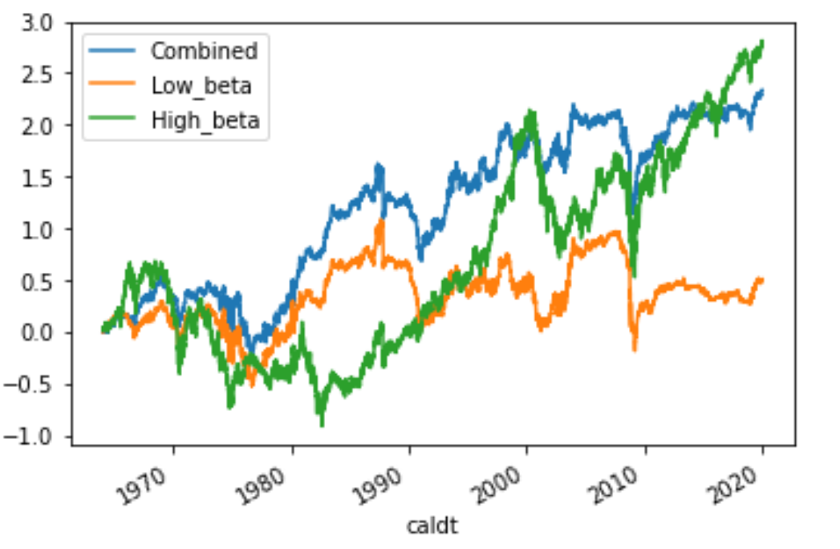
Cumulative Excess Returns
“Beta” of High Portfolio: 1.55
“Beta” of Low Portfolio: 0.15
“Beta” of Combined Portfolio: 0.29

Slide 9
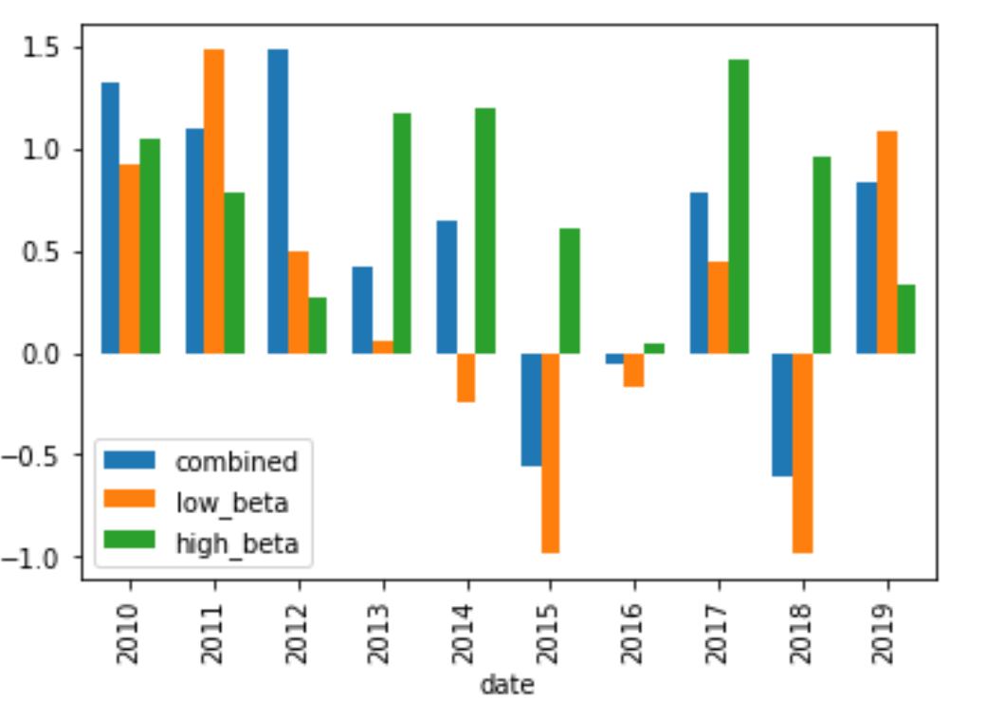
Average Annualized Sharpe Ratio By Year

Slide 10
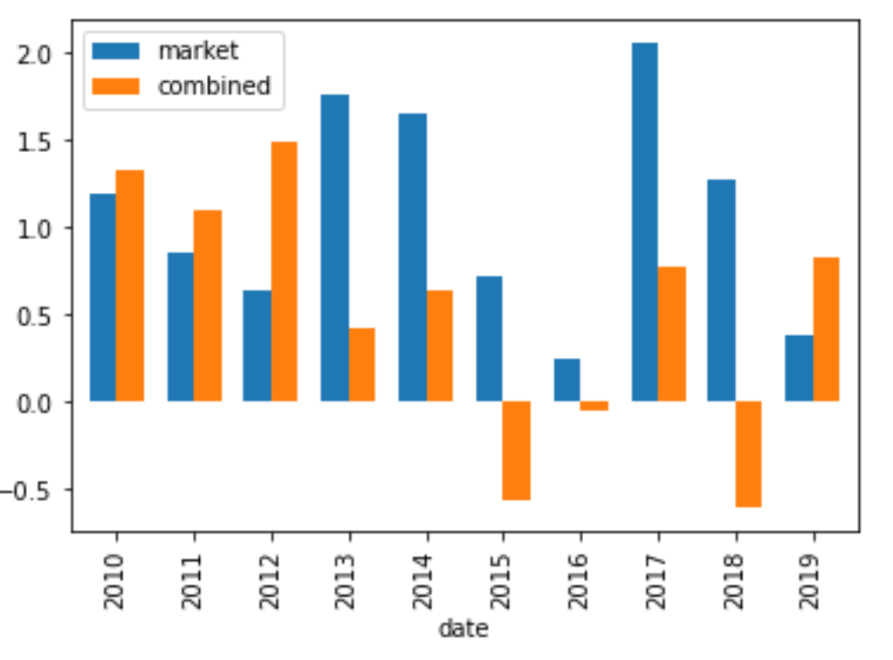
Average Annualized Sharpe Ratio By Year

Slide 11
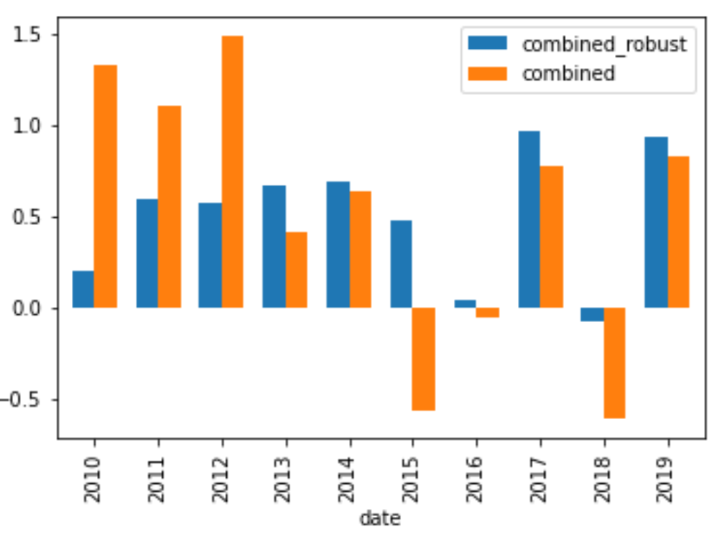
Average Annualized Sharpe Ratio By Year - Robust check
AVERAGE SHARPE RATIO (2010-2019)
Combined strategy: 0.53
Combined_robust strategy: 0.50

Slide 12
Worst a-days to buy high-beta stocks (2010-2019)
Date | Type | Excess returns | Reason
10/10/2018 | PPI | - 4.7% | Rising interest rates
9/21/2011 | FOMC | - 4.6% | Operation twist
2/4/2010 | Emp | - 4.4% | Poor job report
2/5/2016 | Emp | - 4.0% | Stock market volatility
10/29/2014 | FOMC | - 3.6% | Rising interest rates
12/7/2018 | Emp | - 3.6% | Stock market volatility
1/15/2015 | PPI | - 3.5% | Oil price collapse
3/15/2016 | PPI | - 3.4% | Rising interest rate expectations

Slide 13
Long-Short Portfolio
Sum of active weights: 0
Sum of ETF weights: 1
Sum Total: 1

Slide 14
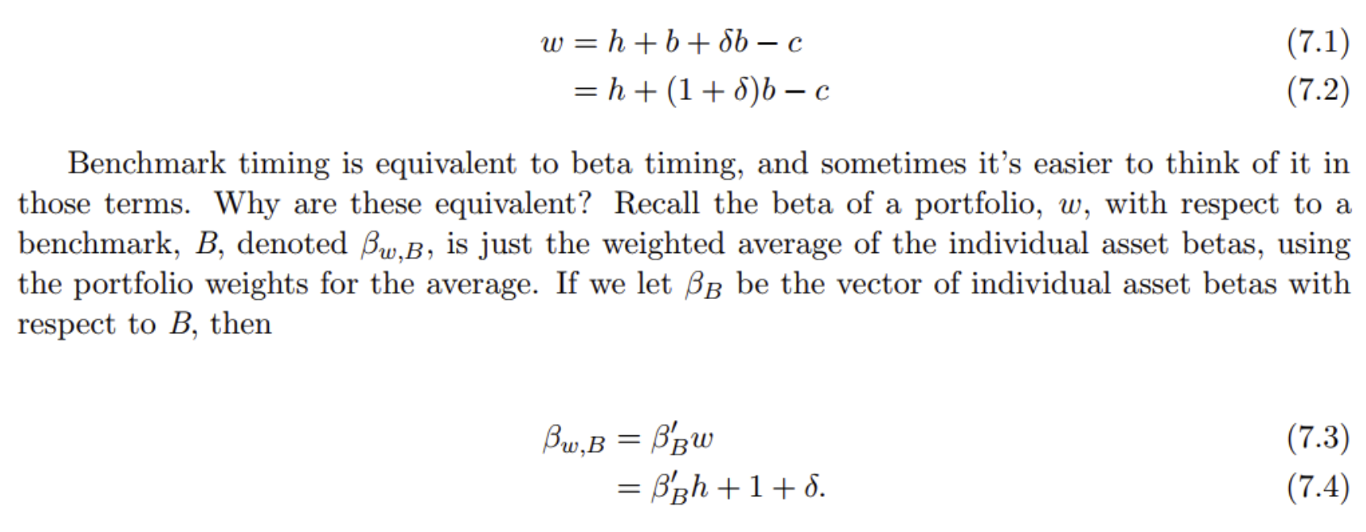
Implementing strategy by increasing exposure to market on a-days

Slide 15
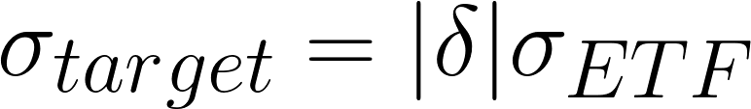
Risk Budgeting
Solve for !

Slide 16

Example
Annualized Risk target = 0.0025
Number of a-days in a year: 32 days
Number of trading days in a year: 252
sigma_ETF: volatility of the market (past 22 days)
Delta: proportion of total assets to borrow in cash to buy ETF

Slide 17
Proposal
Thesis: On a-days, higher beta stocks have higher alpha
Proposal: 0.0025 (0.25%) risk allocation
Buy ETF at open and sell at close on a-days
(optional) can continue through summer
Risks: high beta stocks could react poorly on a-days due to negative news, but ex-ante we think they will do well.

